Slide 1
Georgia Society of CPAs
Tax Forum
Georgia Department of Revenue
August 16, 2023

Slide 2
Agenda
Introductions
Opening Remarks
Special Refund
Division Updates
  Taxpayer Services
  Compliance
  Audit
  Office of Tax Policy

Slide 3
Opening Remarks
Chester Cook
Deputy Commissioner

Slide 4
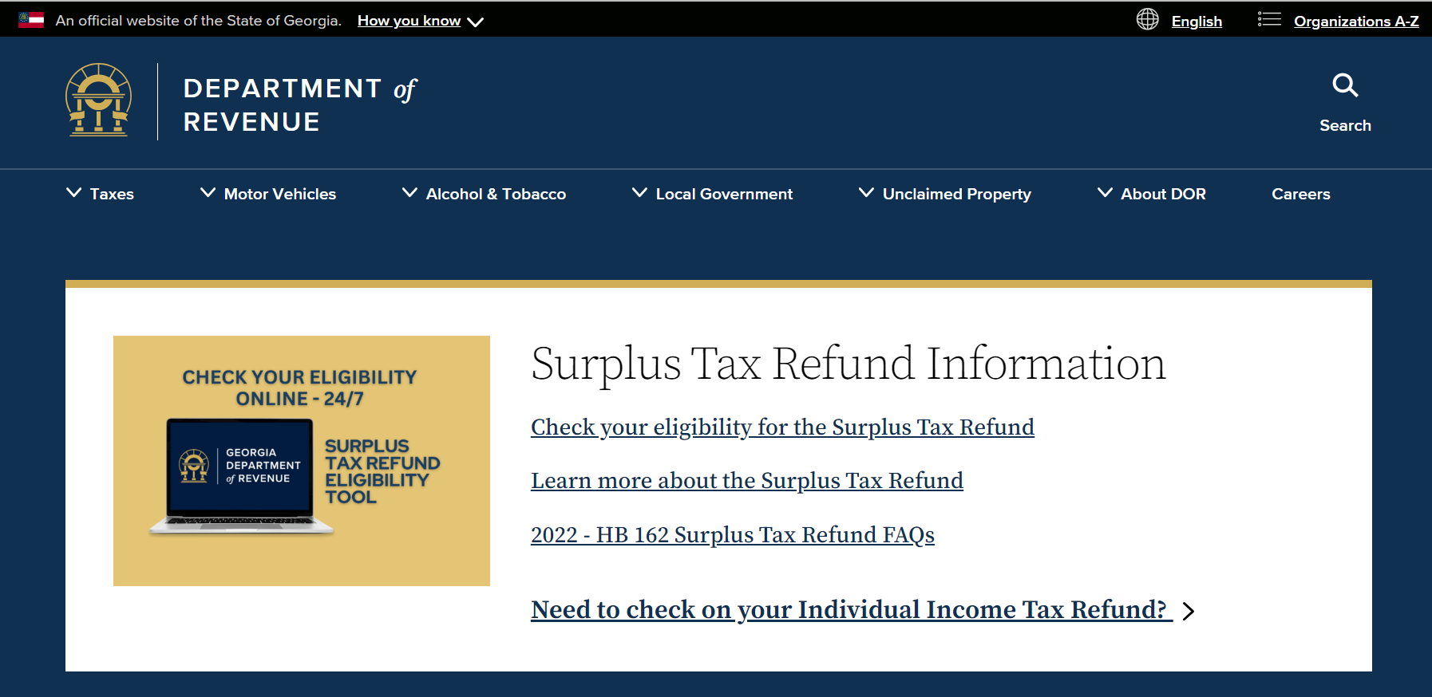
Georgia special refund

Slide 5
Georgia Special refund
Refund year | Amount | Count
2021 | $1,075,259,469 | 4,525,077
2022 | $978,242,453 | 4,154,822
TOTALS | $2,053,501,922 | 8,679,899

Slide 6
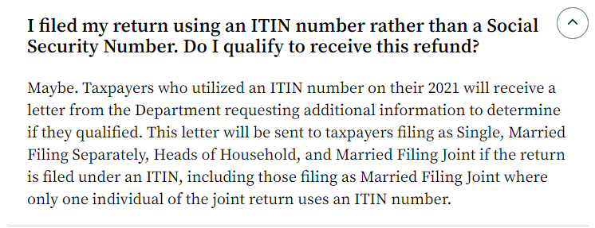
Georgia special refund:
Using GA Individual tax identification Number (ITIN)

Slide 7
Taxpayer Services & processing division
Darcy Pyle
Director

Slide 8
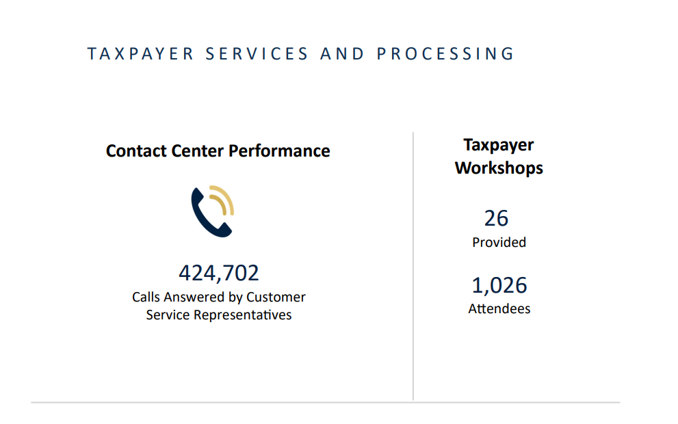
CY2022

Slide 9
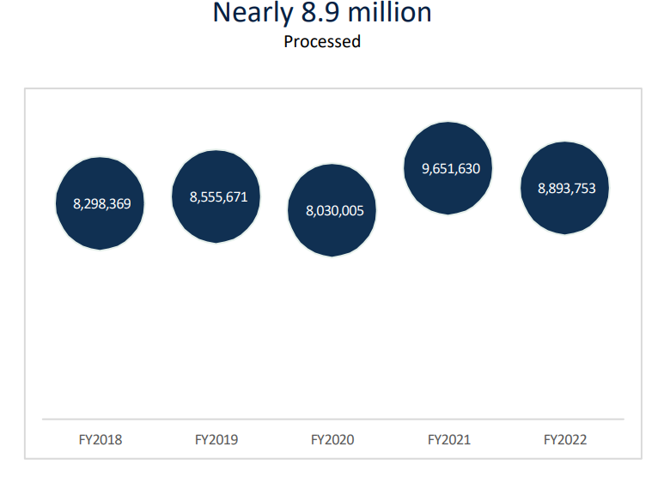
Tax returns processed

Slide 10
Name Change Policy
  Name Change
    Beginning January 1, 2024 the Department will require two forms of ID reflecting the new name
    A copy of one of the following documents:
        Social Security Card
        Legal document reflecting
        Superior Court order/decree/certificate
        Marriage Certificate/Divorce decree
    Plus a copy of a government issued photo id
        US State issued id card (front and back)
        US Passport/Passport Card
    Documents should be submitted with your tax return

Slide 11
Form CHanges

Slide 12
Pass through entity update
Subchapter “S” corporations & partnerships may elect to pay tax at the entity level
  for original returns (2022 forward), OR
  if audited and it results in an amended return (2018 – 2021)
Elections are irrevocable for that year, but may be changed for subsequent years
For tax year 2023 and forward, entities do not have to be 100% wholly owned.

Slide 13
Pass through entity update
Estimated Payments
  An electing pass-through entity is required to make estimated payments in the same manner as a C-Corporation and using the same form
  Due dates are the same as is required for a C-Corporation.
  Subject to the C-Corporation failure to pay estimated income tax penalties.

Slide 14
Pass through entity update
How to Handle Payments
Estimated payments made by owners are not eligible to be transferred to the pass-through entity.
  However, if the owners have made estimated payments or otherwise have credits or other attributes that would reduce their liability,
  Check the "UET Annualization Exception Attached" box on the Form 600S or Form 700 and compute the penalty on Form 600 UET as if the entity had made such payments or applied such credits or attributes.
  Attach the 600 UET with the return.
For purposes of the 100% of the immediately preceding year's tax exception, the entity may check the "UET Annualization Exception Attached" box on the Form 600S or Form 700 and compute the penalty on Form 600 UET assuming the tax for the prior year was equal to 5.75% of the prior's year's income computed pursuant to paragraph (6).

Slide 15
Pass through entity update
How to Handle Payments (con’t)
Owners who make estimated payments must instead claim a refund of the overpayment, for the year the estimates were made for, by filing the income tax form the owner would normally file.
A pass-through entity that makes estimated payments but then does not make the election to pay tax at the pass-through entity level, must instead claim a refund of the overpayment for the year the estimates were made for.
The entity may contact the Department and direct that the payments be transferred to its composite estimated tax account or its nonresident withholding tax account.

Slide 16
Pass through entity update
Will there be an automatic UET exception if there is no prior tax when paying at the entity level?
  No. The law states that the entity is subject to penalty and interest.
  Taxpayer will need to submit a penalty waiver request for consideration.
Should cash basis be utilized when reporting and filing? When should the deduction for a K-1 be taken?
  IRS guidelines can be followed in determining the appropriate reporting method.
  The deduction can be taken when the return is filed.

Slide 17
Pass through entity update
Where do you deduct K-1 income on the individual return if you report the income but elect to pay at the entity level to avoid double taxation?
  Form 500, Schedule 1
Nonresident withholding and nonresident consent agreements are not required for years the PTE elects to pay the entity level
  It is up to the entity to decide how to get consent from its owners,
  (DOR) does not require them to send any consent agreements to DOR
Additional FAQ’s for HB 149 – Pass through Entity Tax can be found on the DOR website:
    https://dor.georgia.gov/hb-149-pass-through-entity-tax-faq

Slide 18
Withholding tax

Slide 19
Tax Year 2023 Changes - Pending
Forms G2-A and G2-RP: Added an allocation schedule
  Fields on the schedule:
    Recipient’s FEIN/SSN
    Recipient’s Legal Name
    Recipient’s Address
    Payer’s GA Withholding Number
    Allocation Total

Slide 20
Individual income tax

Slide 21
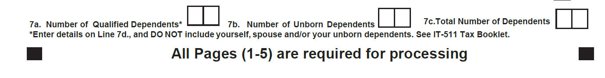
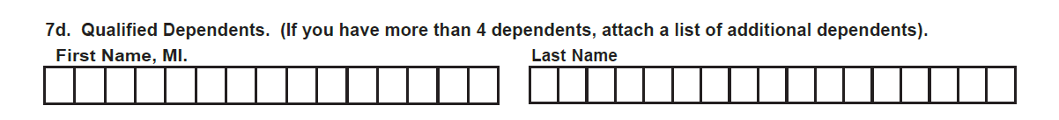
Individual tax year 2023 changes
Forms 500/500X Dependents, Lines 7a-d
  New field for unborn dependents

Slide 22
Individual – proposed changes
Forms 500/500X, Schedule 1, Page 1, Additions
  Additions and Subtractions Sections
    Repurpose the “Reserved” lines to “Depreciation”

Slide 23
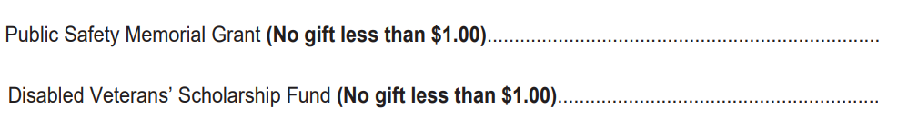
Individual tax year 2023 changes
New Charitable Contribution Line
  Disabled Veteran’s Scholarship Fund
    Form 500EZ: Line 19
    Form 500: Line 40

Slide 24
Individual Tax Year 2023 changes
Forms 500/500X, New NOL Schedule 4
    Separate 2D barcode in addition to the main form
    Type of Loss and Portion
    Part I: Computation
    Part II: NOL Worksheet
    Part III: Carryback

Slide 25
Other Individual Updates
  Organ Donation Expenses Deduction Increase
      For tax years beginning on or after January 1, 2023, the maximum deduction for unreimbursed travel expenses, lodging expenses, and lost wages incurred as a direct result of an organ donation is now $25,000.

Slide 26
Fiduciary tax

Slide 27
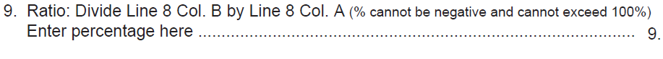
Fiduciary tax year 2023 changes
Forms 501/501X, Schedule 4,
  Ratio line description (% cannot be negative and cannot exceed 100%)

Slide 28
Fiduciary tax year 2023 proposed changes
Forms 501/501X, New NOL Schedule 7
  Add NOL Schedule
    Header
    Type of Loss and Portion
    Part I: Computation
    Part II: Carryback

Slide 29
Corporate income tax

Slide 30
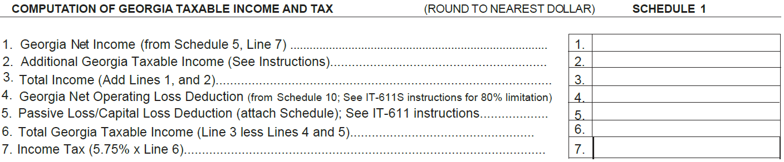
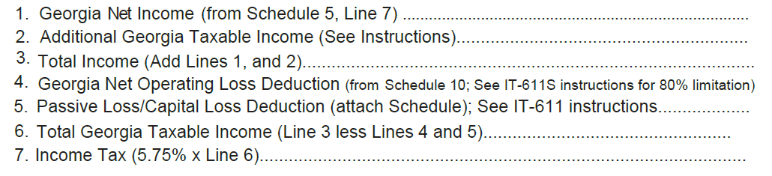
Corporate Tax Year 2023 changes
Form 600S and 600, Schedule 1
  New line for Passive Loss/Capital Loss Deduction

Slide 31
Corporate tax year 2023 changes
Forms 600S and 600S, GA NOL Carry Forward Worksheet
  Added Current Year Loss Types
    Normal Loss
    Farm Loss
    Insurance Loss

Slide 32
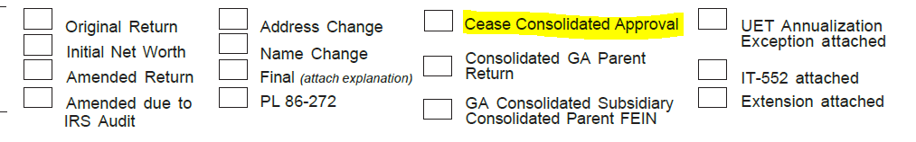
Corporate tax year 2023 changes
Form 600, Consolidated Returns
  HB 1058: Affiliated groups no longer need approval to file consolidated returns
  Checkbox to Cease Consolidated Approval

Slide 33
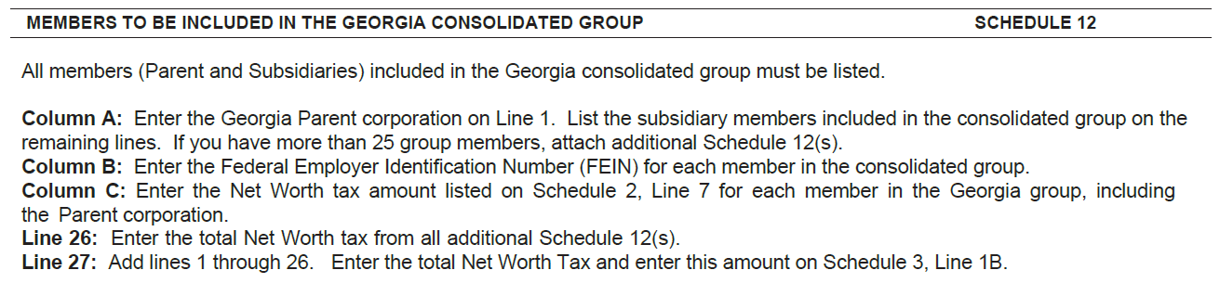
Corporate tax year 2023 changes
Form 600, New Schedule 12
  Members to be Included in the Georgia Consolidated Group

Slide 34
Partnership

Slide 35
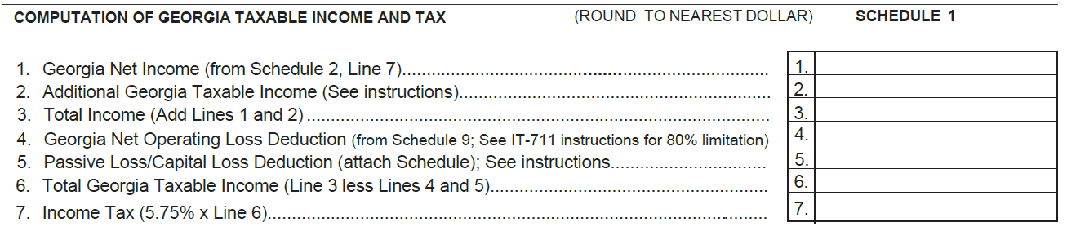
partnership - proposed changes
Form 700, NOL Schedule 1
  New line for Passive Loss/Capital Loss Deduction

Slide 36
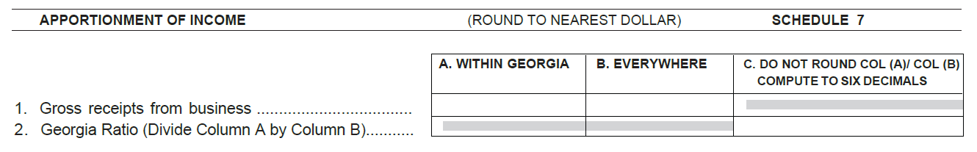
Partnership – Schedule 7 Apportionment
Two types of Ratios
  Within and outside of Georgia income sources
  Only Georgia income sources
Computed on Schedule 7, rolls up to Schedule 2
Ratio should not be rounded up

Slide 37
Tax Credits

Slide 38
Tax Credits tax year 2023 changes
  Tax Credits
  Added credit codes
    150: Qualified Law Enforcement Donation Credit
    151: Qualified Foster Child Donation Credit
    152: Historic Rehabilitation Credit for Historic Homes 2023 and 2024
    153: Historic Rehabilitation Credit for Other Certified Structures 2023 through 2027

Slide 39
Tax credits year 2023 changes
  Tax Credits
  Remove credit codes
    108: Qualified Transportation Credit
    116: Low Emission Vehicle Credit
    117: Zero Emission Vehicle Credit

Slide 40
Tax Credits tax year 2023 changes
  IT-QJ 2022, Update Section C. Project Category
    Replaced location with full address + county

Slide 41
Tax Credits tax year 2023 changes
  New IT-QJ 2023
    For taxable years beginning on or after January 1, 2023, organizations exempt from tax pursuant to Code Section 48-7-25 are “taxpayers” only to extend that a trade or business operated by such organization generates unrelated business income as defined in Section512 of the Internal Revenue Code.
    Such taxpayers qualify to claim the credit only for the projects and investments related to such trade or business and can only elect jobs for such trade or business to qualify as new quality jobs.

Slide 42
Tax Credits tax year 2023 changes
  QEE Individual threshold amounts
      Single, Head of household, Married Filing Separately - $2,500
      Married filing jointly - $5,000

Slide 43
Tax Year 2024
  Individual
    Standard Deduction Changes
      Single, Head of Household, or Married filing separately
        $12,000
      Married filing jointly
        $24,000
      After December 31, 2023, there are no more additional $1,300 deductions for taxpayers who are age 65 or older or blind.

Slide 44
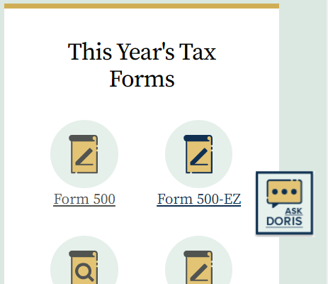
DOR Website Resources
Ask DORIS is a chat bot that will assist with finding items on the DOR web page.
Just click on Taxes and DORIS will appear at the bottom of your screen.
The more you ask the more we add.

Slide 45
DOR Website Resources
For help on GTC
dor.georgia.gov/georgia-tax-center-help
How to submit tax credit pre-approval videos
https://dor.georgia.gov/media/videos
Summary on each credit type: https://dor.georgia.gov/sites/dor.georgia.gov/files/related_files/document/LATP/Publication/Credit%20summaries%209.19.18.pdf
Tax Professional Web Link
  https://dor.georgia.gov/information-tax-professionals
Notes:
We as customers typically do business with those companies that are committed to understanding and satisfying our needs. When one company does not please us, we look for a replacement.
Through success in these categories—customer focused vision, responsiveness to our needs, differentiation in the market, and a drive for continuous improvement—customers will keep coming back for your business. The failure to succeed, however, drives customers to go elsewhere.
Organizations will only be successful if they understand their customers’ needs and continuously improve the processes that deliver those needs and delight their customers. This Lean Six Sigma White Belt course is your next step in becoming a great leader through the effective and efficient management of business processes.

Slide 46
Taxpayer Services Email
Allow ten business days for contact.
Tax Professional Hotline
  revenue.incometaxcpa@dor.ga.gov
Tax Credits
taxcredits.inquiries@dor.ga.gov
Individual Income Tax & Net Operating Losses
revenue.taxpayerservices@dor.ga.gov
Corporate Income Tax
corpissues@dor.ga.gov
Withholding Tax
  Withholding.issues@dor.ga.gov
Sales & Use Tax
salestax.business@dor.ga.gov
Sales Tax Contractors
TSD-sales-tax-contractor@dor.ga.gov
Motor Fuel & IFTA
motorfuel@dor.ga.gov
Notes:
We as customers typically do business with those companies that are committed to understanding and satisfying our needs. When one company does not please us, we look for a replacement.
Through success in these categories—customer focused vision, responsiveness to our needs, differentiation in the market, and a drive for continuous improvement—customers will keep coming back for your business. The failure to succeed, however, drives customers to go elsewhere.
Organizations will only be successful if they understand their customers’ needs and continuously improve the processes that deliver those needs and delight their customers. This Lean Six Sigma White Belt course is your next step in becoming a great leader through the effective and efficient management of business processes.

Slide 47
Taxpayer Services Contacts
Taxpayer Services Contact Center
  1(877) 423-6711
Tax Professional Hotline
  (404) 417-2395
revenue.incometaxcpa@dor.ga.gov
Notes:
We as customers typically do business with those companies that are committed to understanding and satisfying our needs. When one company does not please us, we look for a replacement.
Through success in these categories—customer focused vision, responsiveness to our needs, differentiation in the market, and a drive for continuous improvement—customers will keep coming back for your business. The failure to succeed, however, drives customers to go elsewhere.
Organizations will only be successful if they understand their customers’ needs and continuously improve the processes that deliver those needs and delight their customers. This Lean Six Sigma White Belt course is your next step in becoming a great leader through the effective and efficient management of business processes.

Slide 48
Management Contacts
Darcy Pyle, Director
darcy.pyle@dor.ga.gov
(404) 417-6634
Iseeta Richardson, Assistant Director Monique Williams, Assistant Director
Customer Experience Processing
iseeta.richardson@dor.ga.gov monique.williams2@dor.ga.gov
(404) 417-2447 (404) 724-7564
Notes:
We as customers typically do business with those companies that are committed to understanding and satisfying our needs. When one company does not please us, we look for a replacement.
Through success in these categories—customer focused vision, responsiveness to our needs, differentiation in the market, and a drive for continuous improvement—customers will keep coming back for your business. The failure to succeed, however, drives customers to go elsewhere.
Organizations will only be successful if they understand their customers’ needs and continuously improve the processes that deliver those needs and delight their customers. This Lean Six Sigma White Belt course is your next step in becoming a great leader through the effective and efficient management of business processes.

Slide 49
Darcy Pyle
(404) 417-6634
Director
darcy.pyle@dor.ga.gov

Slide 50
Division Highlight:
Compliance
Kerry Herndon, Director
Joel Gilbert, Assistant Director
Tiffany Powers, Program Manager
Jill Smith, Program Manager

Slide 51
Compliance Division Overview
Who are we?
What do we do?

Slide 52
Compliance Units Overview
Regional Offices
Central Collections
Income Tax Collection Section
Lottery
Compliance Project Team
Office of the Director

Slide 53
Regional Offices
11 Regional Offices across the State (Albany, Athens, Atlanta, Augusta, Cartersville, Columbus, Douglas, Gainesville, Macon, Savannah, South Metro).
Handles active business collection cases including Offer-in-Compromise (OIC), enforcement actions and taxpayer assistance.
Accounts worked “globally” – cases are not always worked by an agent in the nearest Regional Office. Allows more accounts in metro areas to be worked.
160 Positions
Program Manager: Jill Smith (Jill.Smith@dor.ga.gov)

Slide 54
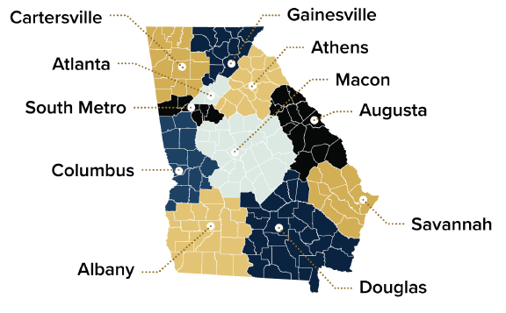
Regional Offices

Slide 55
Managers of the Regional Offices
Albany: James Cox (James.Cox@dor.ga.gov)
Athens: Daryl Smith (Daryl.Smith@dor.ga.gov)
Atlanta: Gezu Worku (Gezahegne.Worku@dor.ga.gov)
Augusta: Tabitha Strickland (Tabitha.Strickland@dor.ga.gov)
Cartersville: Lisa Meek (Lisa.Meek@dor.ga.gov)
Columbus: Taryn Parker (Taryn.Parker@dor.ga.gov)
Douglas: Beth Lankford (Elizabeth.Lankford@dor.ga.gov)
Gainesville: Laura Sargent (Laura.Sargent@dor.ga.gov)
Macon: David Jones (David.Jones@dor.ga.gov)
Savannah: Jackie Nix (Jacqueline.Nix@dor.ga.gov)
South Metro: John Davis (John.Davis@dor.ga.gov)

Slide 56
Central Collections
Located in Century Center (HQ).
Handles closed business collection matters including OICs, bankruptcy for individuals and businesses, and real estate matters involving liens.
24 Positions
Manager: Anjanee Burns (Anjanee.Burns@dor.ga.gov)
Program Manager: Tiffany Powers (Tiffany.Powers@dor.ga.gov)

Slide 57
Income tax collection section
Located in Century Center (HQ).
Handle inbound calls for income tax lien releases, payment plan requests and TOP offsets.
Reviews work items related to Income Tax Collection Cases (account maintenance, payment plans, penalty waivers, etc.)
Make outbound calls to high priority Income Tax cases
37 Positions
Manager: Derrick Moore (Derrick.Moore@dor.ga.gov)
Program Manager: Tiffany Powers (Tiffany.Powers@dor.ga.gov)

Slide 58
lottery
Located in Century Center (HQ).
Handles the clearance process for businesses that have submitted applications to GA Lottery for retailer and COAM licenses. Also handles prize validation calls, in which winners accounts are reviewed to determine if a debt exists.
6 Positions
Supervisor: Latonya Odie (Latonya.Odie@dor.ga.gov)
Program Manager: Tiffany Powers (Tiffany.Powers@dor.ga.gov)

Slide 59
Compliance project team
Located in Century Center (HQ).
Reviews and handles all computer system issues submitted by Compliance Units. Submits change requests on behalf of the division and ensures that all completed changes are tested prior to production. Handles Compliance related projects.
3 Positions
Program Manager: Tiffany Powers (Tiffany.Powers@dor.ga.gov)

Slide 60
Office of the Director
Located in Century Center.
Handles administrative tasks for the Compliance Division.
6 Positions:
  Kerry Herndon, Director (Kerry.Herndon@dor.ga.gov)
  Joel Gilbert, Assistant Director (Joel.Gilbert@dor.ga.gov)
  Jill Smith, Program Manager (Based out of Cartersville RO)
  Tiffany Powers, Program Manager
  Merrill Jacobson, Attorney
  Angela Branyon, Administrative Assistant

Slide 61
Collection initiatives
Financial Institution Data Match (FIDM) – Senate Bill 201
Treasury Offset Program (TOP)
Voluntary Compliance Programs
  Installment Payment Agreements (IPAs)
  Offer in Compromise (OIC)
  Penalty Waivers
Notes:
That’s who we are, what do we do?

Slide 62
SB201 - Financial institution data match (FIDM)
What is it?
  Allows the Department, through a 3rd party, to request identification of any account a financial institution may hold with respect to the delinquent taxpayer identified in the request.
How will it be used?
  Information obtained through FIDM can only be used for the collection of a delinquent tax liability under an active lien.
  The information will allow the Department to pinpoint enforcements rather than use a scattered collection approach.

Slide 63
Treasury offset program (TOP)
What is the Treasury Offset Program?
  Under Federal Law, the Georgia DOR can take a Federal IT refund to reduce or pay income tax debt owed to the State of Georgia.
How it works?
  A letter is sent to the last known address of a person notifying them of the Department’s intent to file an offset claim
  After 60 days, a claim is filed with the Treasury Department
  The Treasury Department notifies the person when they send all or part of the federal refund.
Plain Language applied to TOP Notice of Intent to Offset – Reduces phone calls

Slide 64
Voluntary Compliance Programs (IPA)
Installment Payment Agreement (IPA)
  What is it?
    An Installment Payment Agreement is a contract between a delinquent taxpayer and the Department.
  How does it work?
    Allow up to 60 months
    Minimum payment of $25
    Fee to set up IPA
    Penalty and Interest continues to accrue while payments are made
  Over 48,000 active payment plans
  Approximately $10.5 million collected per month

Slide 65
Voluntary Compliance programs (OIC)
Offer-in-Compromise
  What is it?
  A program that allows a taxpayer to settle for a lessor amount than is due. Must fall under one the following:
    Doubt as to collectability
    Doubt as to liability
  How does it work?
  Taxpayer applies using Form OIC-1 and Financial Statements (Doubt as to Collectability only)
  Application Fee $100.00
  Lump Sum or Installment Plan available
  Over 1400 OICs processed in 2022
  Over 60% acceptance rate

Slide 66
Voluntary Compliance programs (penalty waivers)
Penalty Waiver
  What is it?
  A program that allows a taxpayer to request the Department forgive assessed penalties:
    Must demonstrate reasonable cause. Did the TP act as a reasonable person would have?
    Authority granted to the Commissioner by OCGA 48-2-43 .
  How does it work?
  Taxpayer requests a waiver either through GTC (preferred) or Form TSD-3.
  Can be requested in conjunction with IPA
  Over 60,000 requests in 2022
  Over $54,000,000 in penalties waived in 2022

Slide 67
More Information
Websites:
  Georgia Tax Center: www.gtc.dor.ga.gov
  Department of Revenue: www.dor.ga.gov
Email Addresses:
  Compliance@dor.ga.gov
  Payment.plan@dor.ga.gov
  Solved.Lienclearance@dor.ga.gov

Slide 68

Questions?

Slide 69
audit Division

Slide 70
Division Highlight:
Audits
Tommy cooper, CPA - Director
Denny Mwangi - Assistant Director

Slide 71
audits Division Overview
Who are we?
What do we do?

Slide 72
Audits division Organization
Tommy Cooper
Director
Nicole Jenkins
Exec. Admin. Asst.
Denny Mwangi
Asst. Director
Income Taxes
Vacant
Asst. Director
Transaction Taxes
Suzan Reusch
Audit Manager
Sales & Use (OOS)
Dennis Bono
Audit Manager
Sales & Use (OOS)
Jennifer Combs
Audit Manager
Sales & Use (OOS)
Chesy Thomas
Audit Manager
Sales & Use
Mary Catherine Passmore
Audit Manager
Sales & Use
Emmanuel Nwogor
Audit Manager
IFTA/IRP/MF
Brian Shanaghan
Audit Manager
Film
Mike Edwards
Audit Manager
Corporate
Bill Esmond
Audit Manager
Corporate (OOS)
Rufus Payne
Audit Manager
Individual
Sharon Cleghorn-Martin
Business Analyst
Vladimir Durandin
Business Analyst
134 Total Employees
66 In-state Auditors
42 Out-of-state Auditors
Avg. collections per auditor - $1.7M

Slide 73
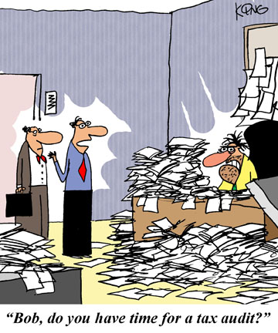
What we do
Audit all taxes administered by DOR except alcohol and tobacco excise taxes
Review and process Voluntary Disclosure Agreements
Administer Streamlined Sales Tax program
FY23 completed approx. 75k audits which resulted in collections of $178M
  Individual and Business Income Taxes
  Business Occupation Tax
  Composite Tax
  Sales & Use Tax
  Motor Fuel Tax
  International Fuel Tax
  International Registration Plan
  Film Tax Credit
  State Hotel/Motel Fee
  Fireworks Excise Tax
  Adult Entertainment Tax
  Prepaid Wireless 911 Fee
  Transportation Services Tax

Slide 74
AUDITS OVERVIEW
INCOME TAX GROUP
  Business Income Tax Audits (Corporate and
  Pass-Through Entities)
  Individual Income Tax Audits
  Film Tax Credit Audits
  Voluntary Disclosures
TRANSACTION TAX GROUP
  Sales/Use and Miscellaneous Tax Audits
  IFTA/IRP/Motor Fuel Audits
  Streamlined Sales Tax

Slide 75

FILM tax credits
Georgia’s Film Tax Credit provides a 20% tax credit on qualified productions with an optional 10% uplift if certain criteria are met
Beginning January 2023 all credit must undergo a mandatory audit, either by DOR audit staff or approved 3rd party auditors
DOR auditors completed 43 audits in FY23 with a staff of 9 auditors

Slide 76
Individual income tax
For FY23 we completed approximately 73k audits and collected $14M
Audits conducted by Individual Income Tax Unit utilize tax software and IRS leads to generate audits
  EOAD (Examination Operational Automation Database)- Audit performed by IRS, as a result additional tax is due to Georgia
  CP-2000 Audits- Billings performed by IRS based on missing income i.e., W-2, 1099, 1099R
  CAA (Computer Assisted Audits) Audits generated from matching data between the IRS and the State of Georgia
  Delinquents – Audits generated from matching data from the IRS and the State of Georgia (Taxpayers who have filed Federal Returns but not Georgia Returns).
  Assorted Manual Audits (emphasis may vary year to year) Schedule C audits, Credit audits etc.

Slide 77
Business income tax
Two teams, one in-state and one out-of-state
Out-of-State Corporate Team is comprised of 7 Auditors and 1 Audit Manager operating out of 6 states conducting corporate audits some of which are collaborative audits with MTC
In-State Corporate Team is comprised of 7 Auditors and 1 Audit Manager conducting Georgia-based corporate audits
Audits Corporate and Pass-Through Entity Income Tax and Non-Resident Withholding Tax
Completed 2,124 audits in FY23 with $136M in collections

Slide 78
Voluntary disclosures
Voluntary Compliance Program- requirements to participate:
  1) No prior DOR Contact
  2) Current with all other DOR obligations and filings
  3) Filing of required returns and payment of interest and tax within VDA terms
VDA program generated $35M in tax revenues in FY23
Voluntary Disclosure Agreements | Georgia Department of Revenue
vda@dor.ga.gov

Slide 79
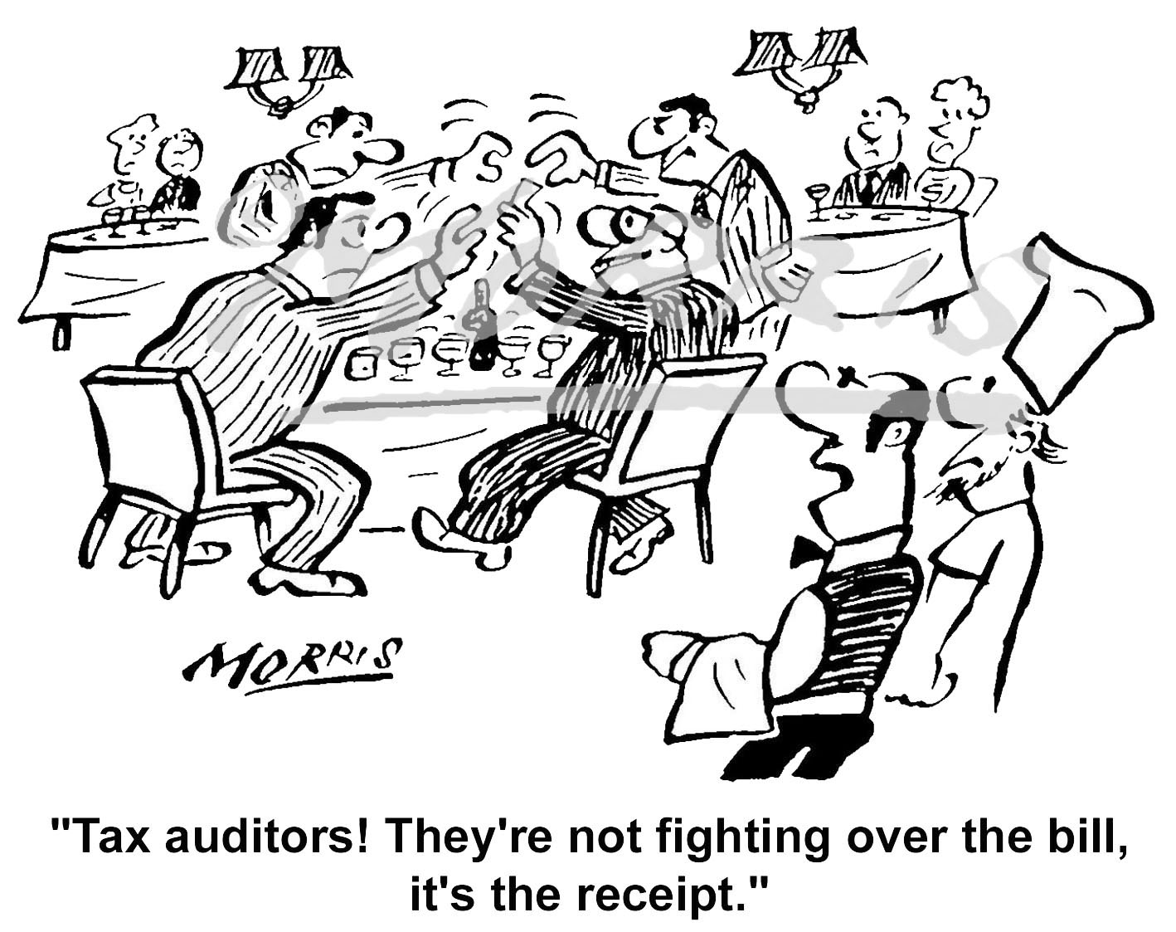
Sales & use taxes
Primarily audits sales and use tax, but also audits transportation service tax, prepaid wireless 911 fee, fireworks excise tax, state hotel/motel fee, and adult entertainment tax
Conducts reviews of withholding as part of sales tax audits
5 teams – one based at Century Center, one in regional offices throughout the state, and 3 out-of-state teams distributed throughout the country
Completed 803 audits in FY23 with collections of $75M
46 auditors total
  22 In-state
  24 Out-of-state

Slide 80

Ifta/irp/motor fuel tax
IFTA and IRP agreements require us to audit a minimum of 3% of the registrations in the state
Completed 758 audits in FY23 with collections of $580k
21 auditors

Slide 81
Digital Goods tax (SB56)
Senate Bill 56 created a new tax on specified digital products defined in O.C.G.A. §48-8-2(11)
Examples:
Digital audio video works
Digital audio works
Artwork
Photographs
Periodicals
Newspapers
Magazines
Video or audio greeting cards
Video Games
Electronic entertainment
Only taxable when end user receives the right of permanent use
Does NOT apply to subscriptions or rentals
Effective January 1, 2024

Slide 82
Questions?

Slide 83
Office of tax policy

